Slide 1
PART 4
DATA STORAGE AND QUERY

Slide 2
Introduction to Chapter10 and Chapter11
In view of physical DB, two issues should be addressed
  data organization in DBS, i.e. physical storage structure of data — Chapter10
  data access in DBS — Chapter11
目标
1. 开发数据库应用系统时，根据DBMS提供的机制，选择合适的数据库物理结构
2. 在数据库表上合理设置索引，提高数据查询速度

Slide 3
Chapter 10
Storage and File Structure

Slide 4
Main Contents in This Chapter
File organization (at physical level, §10.5)
Organization of records in files (at logical level, §10.6 ),
i.e. file structures
Data-dictionary Storage (§10.7)
Data Buffer (§10.8)

Slide 5
文件逻辑/物理组织 in Operating System Concepts
逻辑结构：
流式文件, 基于记录文件
物理结构：以block为单位，进行存储
contiguous相邻的, linked, indexed

Slide 6
10.5 File Organization
The database is stored as a collection of DB files.
Each file is a sequence of records. A record is a sequence of fields.
One approach:
  assume record size is fixed
  each file has records of one particular type only
  different files are used for different relations
  This case is easiest to implement; will consider variable length records later.
Notes:
数据库映射到文件的一种方法是：定长的记录；另一种方法是变长记录形式

Slide 7
File Organization (conmt.)
Each file is a sequence of records, and a relational table is a set of tuples
/*以元组为单位的DB逻辑文件在以记录为单位的OS物理文件中如何实现??
How to represent the tuple as the record in files?
  fixed-length records
  variable-length records

Slide 8

10.5.1 Fixed-Length Records
Simple approach:
  Store record i starting from byte n ∗ (i – 1), where n is the size of each record.
  Record access is simple but records may cross blocks
    Modification: do not allow records to cross block boundaries
instructor(ID, name, dept, salary)
Notes:
块是存储分配和数据传输的基本单位。
每个文件分成定长的存储单元，成为块。
每个块通常包含N条记录。

Slide 9
Fixed-Length Records
Deletion of record i:
alternatives:
  move records i + 1, . . ., n
  to i, . . . , n – 1
  move record n to i
  do not move records, but
  link all free records on a
  free list
all records are stored in a contiguous space

Slide 10

Deleting record 3 and compacting把…紧压

Slide 11

Deleting record 3 and moving last record

Slide 12

Free Lists
Store the address of the first deleted record in the file header.
Use this first record to store the address of the second deleted record, and so on
Can think of these stored addresses as pointers since they “point” to the location of a record.
More space efficient representation: reuse space for normal attributes of free records to store pointers. (No pointers stored in in-use records.)

Slide 13
10.5.2 Variable-Length Records
Variable-length records arise in database systems in several ways:
  Storage of multiple record types in a file, e.g. Multitable Clustering File Organization in 10.6.2
  Record types that allow variable lengths for one or more fields such as strings (varchar)
  Record types that allow repeating fields, e.g. multi-set, multi-value attribute (used in some older data models).
Notes:
多表聚簇文件组织

Slide 14
Variable-Length Records
Attributes in the record are stored in order
  fixed length attributes at first, and then the variable-length attributes
Variable length attributes represented by fixed size (offset偏置, length), with actual data stored after all fixed length attributes
Null values represented by null-value bitmap位图

Slide 15

instructor: ID(varch) name(varch) dept(varch) salary(int)
ID
name
dept
salary
Fig. record 0 is stored in contiguous 46 bytes (0-45)
Variable length attributes represented by fixed size (offset, length), with actual data stored after all fixed length attributes
Null values represented by null-value bitmap
The slotted page分槽页结构(e.g. SQL Server2005) structure is often used to organize variable-length records
Notes:
变长记录的表示：
通常包含两部分，初始部分是定长属性，接下来是变长属性。
对于变长属性，在记录的开头给出一个对值（偏移量，长度），偏移量：变长属性在记录中的位置；长度：属性的字节长度。
分槽页结构

Slide 16

Variable-Length Records: Slotted Page Structure
The storage space is divided into fixed-sized slotted pages, and records are allocated to slotted pages, e.g. MS SQL Server
r_{i+3}
r_{i+2}
r_{i+1}
r_{i}
Fig. record_{i} to record_{i+3} in a page
Slotted page header contains
  number of record entries（条）
  end of free space in the block
  location and size of each record
Notes:
分槽的页结构：用于在块中组织记录，用于处理在块中存储变长记录的问题。

Slide 17
Records can be moved around within a page to keep them contiguous with no empty space between them
  e.g. r_{i} is deleted
  entry in the header must be updated
Pointers should not point directly to record — instead they should point to the entry（条 ） for the record in header
  e.g. the pointer to r_{i}
r_{i+3}
r_{i+2}
r_{i+1}
r_{i}

Slide 18
10.6 Organization of Records in Files
/* 文件包括多个记录，这些记录在磁盘上的存放属于文件(记录)结构问题，即记录的组织结构
/*对于某种结构的文件如何去查找、插入、删除记录，属于文件的存取方法
/*文件的记录结构决定了文件的存取方法
At the logical file level, from viewpoints of users, DB file can be viewed as a set of records, these records are logically organized in one of the following ways
  heap, sequential, hash, clustering
  logical organization of records also determine for file users how to access the records, i.e. access methods

Slide 19
Organization of Records in Files
Heap – a record can be placed anywhere in the file where there is space
Sequential – store records in sequential order, based on the value of the search key of each record
Hashing – a hash function computed on some attribute of each record; the result specifies in which block of the file the record should be placed
Records of each relation may be stored in a separate file. In a multitable clustering file organization records of several different relations can be stored in the same file
  Motivation: store related records on the same block to minimize I/O
Notes:
堆文件组织
顺序文件组织
散列文件组织
多表聚集文件组织

Slide 20
Heap File Organization
Any record can be placed anywhere in the file where there is space for the record
There is no ordering of records
Typically, there is a single file for a relation
/* 一般以记录的输入顺序为序，决定了文件中记录顺序
/*记录的存储顺序与记录中的主键无关

Slide 21
10.6.1 Sequential File Organization
Records are logically ordered by search-keys, that is, records are stored in sequential order, based on the value of the search key of each record
  it is desirable that the records are also physically stored in search-key order, or as close to search-key order as possible
    to minimize the number of block accesses in sequential processing
From viewpoints of DB, sequential access to the file
Need to reorganize the file from time to time to restore
sequential order

Slide 22

Sequential File Organization
Suitable for applications that require sequential processing of the entire file
The records in the file are ordered by a search-key

Slide 23

Deletion – use pointer chains
Insertion –locate the position where the record is to be inserted
  if there is free space insert there
  if no free space, insert the record in an overflow block
  In either case, pointer chain must be updated
Need to reorganize the file
from time to time to restore
sequential order
Notes:
溢出块

Slide 24
10.6.2 Clustering File Organization
/*一个DB文件可以存储来自多个关系的记录。不同关系中有联系的记录存放在同一block中，以提高查找和I/O速度
  Store several relations in one file using a multitable clustering file organization, i.e. records of several different relations are stored in the same file
  motivation: store related records on the same block to minimize I/O

Slide 25



Multitable Clustering File Organization
/一个DB文件存储来自多个关系的记录。不同关系中有联系的记录存放在同一block中，以提高查找和I/O速度
department
instructor
multitable clustering
of department and
instructor

Slide 26

Multitable Clustering File Organization
good for queries involving department instructor, and for queries involving one single department and its instructors
bad for queries involving only department
results in variable size records
Can add pointer chains to link records of a particular relation

Slide 27
Hashing File Organization
The file records are stored in a number of buckets, the #bucket is the address of the record
A hash function on some attributes of file records (i.e. search key) is used to determine the addresses of the records in the file
Hash function
  h : {search key} → {physical address of the records}
  the result of the function specifies in which block/bucket of the file the record should be placed

Slide 28
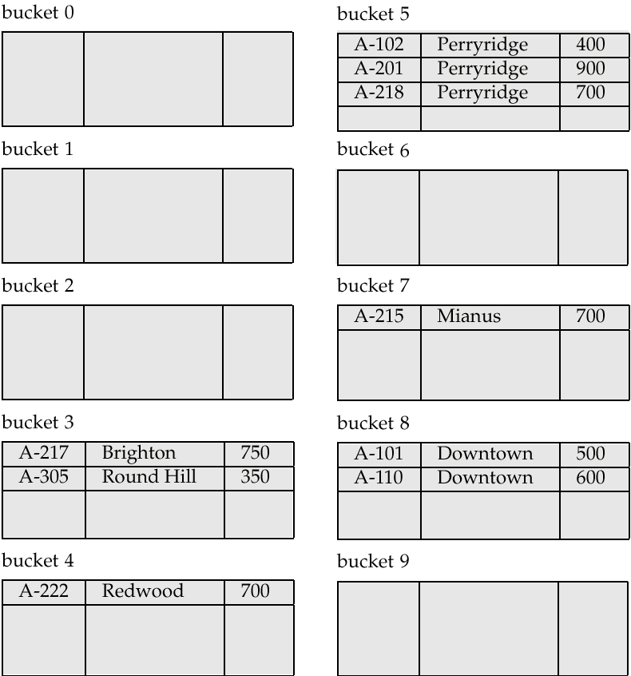
Hash file organization of account file, using branch-name as the search key

Slide 29
10.7 Data Dictionary Storage
The Data dictionary (also called system catalog) stores metadata; that is, data about data, such as
Information about relations
  names of relations
  names, types and lengths of attributes of each relation
  names and definitions of views
  integrity constraints
User and accounting information, including passwords
Statistical and descriptive data
  number of tuples in each relation

Slide 30
Data Dictionary Storage (cont.)
Physical file organization information
  how relation is stored (sequential/hash/…)
  physical location of relation
Information about indices (Chapter 11)

Slide 31

Relational Representation of System Metadata
Relational representation on disk
Specialized data structures designed for efficient access, in memory

Slide 32
10.8 Buffer Management
A database file is partitioned into fixed-length storage units called blocks. Blocks are units of both storage allocation and data transfer.
Database system seeks to minimize the number of block transfers between the disk and memory. We can reduce the number of disk accesses by keeping as many blocks as possible in main memory.
Buffer – portion of main memory available to store copies of disk blocks.
Buffer manager – subsystem responsible for allocating buffer space in main memory
  e.g. in MS SQL Server, the buffer size is an adjustable parameter that has impact on the system performance, e.g. throughput吞吐量

Slide 33
10.8.1 BufferManager 缓存区
Programs call on the buffer manager when they need a block from disk
  1. if the block is already in the buffer, buffer manager returns the address of the block in main memory
  2. if the block is not in the buffer, the buffer manager
    allocates space in the buffer for the block
      Replacing (throwing out) some other block, if required, to make space for the new block.
      Replaced block written back to disk only if it was modified since the most recent time that it was written to/fetched from the disk.
    reads the block from the disk to the buffer, and returns the address of the block in main memory to requester.

Slide 34
10.8.2 Buffer-Replacement Policies
Most operating systems replace the block least recently used (LRU strategy)
Idea behind LRU – use past pattern of block references as a predictor of future references
Queries have well-defined access patterns (such as sequential scans), and a database system can use the information in a user’s query to predict future references
  LRU can be a bad strategy for certain access patterns involving repeated scans of data

Slide 35
Buffer-Replacement Policies
  LRU can be a bad strategy for certain access patterns involving repeated scans of data
    For example: when computing the join of 2 relations r and s by a nested loops
    for each tuple tr of r do
    for each tuple ts of s do
    if the tuples tr and ts match …
  Mixed strategy with hints on replacement strategy provided
  by the query optimizer is preferable

Slide 36
Buffer-Replacement Policies (Cont.)
Pinned钉住block – memory block that is not allowed to be written back to disk.
Toss抛-immediate strategy – frees the space occupied by a block as soon as the final tuple of that block has been processed
Most recently used (MRU) strategy – system must pin the block currently being processed. After the final tuple of that block has been processed, the block is unpinned, and it becomes the most recently used block.

Slide 37
Appendix A
§10.1-10.4 Physical Storage Media
10-I-1. Storage-device hierarchy (§10.1)
As shown in Fig.10.1
Hierarchy
  primary storage, secondary storage, tertiary storage
Performance index
  reliability, speed, capacity, cost

Slide 38

Performance Indicators
Reliability
Speed
Capacity
Cost
fast
small
high
primary
storage
volatile
nonvolatile
secondary
storage
tertiary
storage
slow
large
low
Fig.11.1 Storage-device hierarchy
Volatile 不稳定的

Slide 39
Storage Hierarchy (Cont.)
primary storage: Fastest media but volatile (cache高速缓冲存储器, main memory).
secondary storage: next level in hierarchy, non-volatile, moderately fast access time
  also called on-line storage
  E.g. flash memory快闪存储器, magnetic disks
tertiary storage: lowest level in hierarchy, non-volatile易变的， slow access time
  also called off-line storage
  E.g. magnetic tape, optical storage

Slide 40
Magnetic Disk
The disk structure is shown in next slide
Access time is taken as the performance measures of disks
  the time it takes from when a read or write request is issued to when data transfer begins
Access time includes
  seek time – time it takes to reposition the arm over the correct track.
    4 to 10 milliseconds on typical disks
  rotational latency转动周期– time it takes for the sector扇区to be accessed to appear under the head.
    4 to 11 milliseconds毫秒on typical disks (5400 to 15000 r.p.m.)

Slide 41

11-I-2 Magnetic Disk
(3)
(5)
seeking
(4)
(1)
rotation
磁柱
(2)
Moving-head disk mechanism
磁道(tract),扇区(sector)，柱面(cylinder)，盘片(platter)，旋转(rotation)，
磁盘臂(disk arm)，读写头(read-write head)，磁盘臂组件(arm assembly)，主轴（spindle)

